Slide 1


INTERNET AND MOBILE PROGRAMMING
PROJECT: DESIGN AND IMPLEMENTATION OF A MARKET MANAGEMENT SYSTEM
TASK 5: DATABASE DESIGN AND IMPLEMENTATION
COURSE INSTRUCTOR:
Dr. Nkemeni Valery

Slide 2
Group members
NAME | MATRICULE
FORMASIT CHIJOH FOKUNAG | FE20A041
GAMUAH PADJINOU RYANE JOY | FE20A044
MOSONGO ADINA SAKWE NANGERI | FE20A066
NDALEGH NOELA LUM MBAH | FE20A070
RACHEAL NKONGHO TAFONGOH | FE20A100

Slide 3

TABLE OF CONTENTS
SELLAM DATABASE OVERVIEW
INTRODUCTION
CLASS DIAGRAM
ENTITY RELATIONSHIP DIAGRAM
DATABASE STRUCTURE AND DATA TYPES
VENDOR TABLE
PRODUCTS TABLE
MARKET TABLE
SHOP TABLE
SHOP PRODUCTS TABLE
MARKET PRODUCTS TABLE

Slide 4

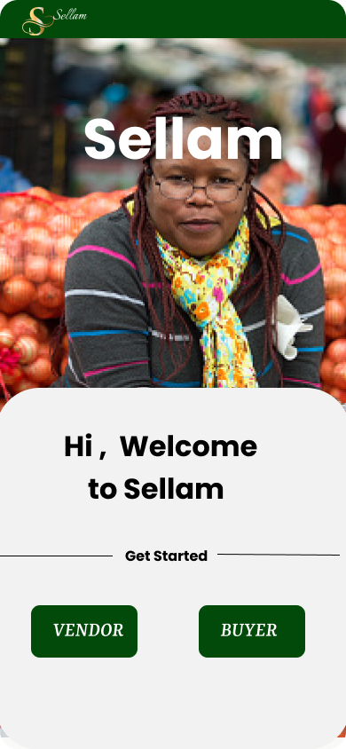

SELLAM
The Sellam app is a market management application which functions on the use of a centralized database with a relational database architecture.
This is brought about by the non-complexity of data, the similarities in market structure, operations and products (hence no need for distributed database) and also the relationships which exists between the objects of the system including buyers, vendors, shops and products (hence the relational database schema)

Slide 5


INTRODUCTION
What is a database?
In order to design the database, the data to be stored must be identified.
STEP 1: CLASS DIAGRAM
STEP 2: Entity Relationship Diagram (ER-DIAGRAM)
STEP 3: Relational Schema

Slide 6
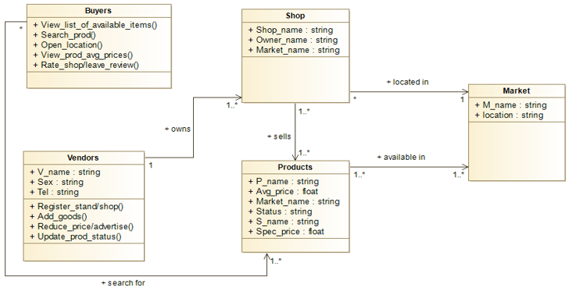
Class diagram
The class diagram shows the different entities in the application, and the inter-relationship between them.

Slide 7
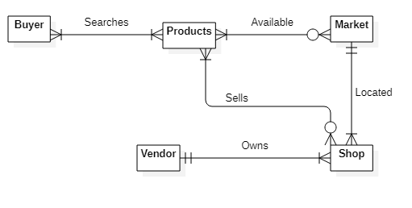
ENTITIY RELATIONAL DIAGRAM (er DIAGRAM)
A buyer searches for one or more products, and a product can be requested by one or more buyers.
A product can be available in zero or more markets, and a market has at least one product.
A market has one or more shops, but a shop can be found in one and only one market.
A vendor may own one or more shops, and a shop is owned by only one vendor.
A product can be found in zero or more shops, and a shop can sell one or more products.

Slide 8
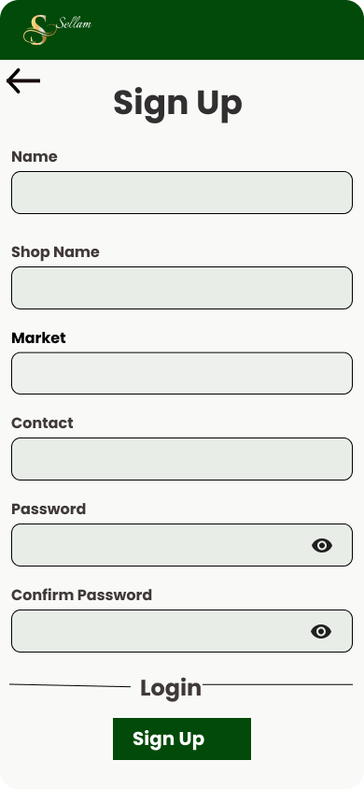
DATABASE STRUCTURE AND DATA TYPES
VENDORS TABLE
Here, we keep track of the vendor’s name, gender (Default set), password and contact.
Database

Slide 9
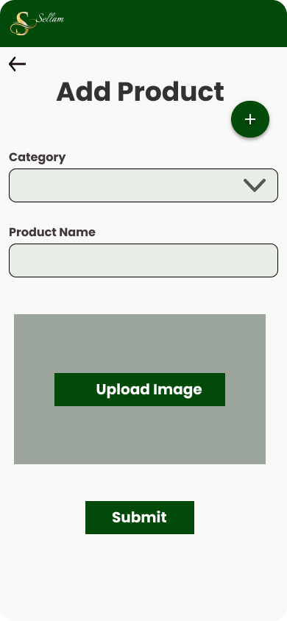

DATABASE STRUCTURE AND DATA TYPES
PRODUCTS TABLE
The product name, category and average price (system calculated) are stored in this table.
Database
Product Image repository

Slide 10
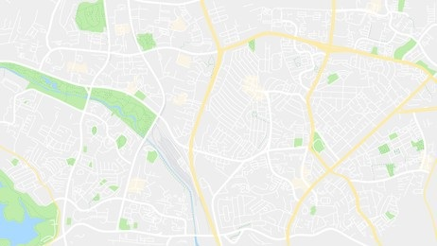
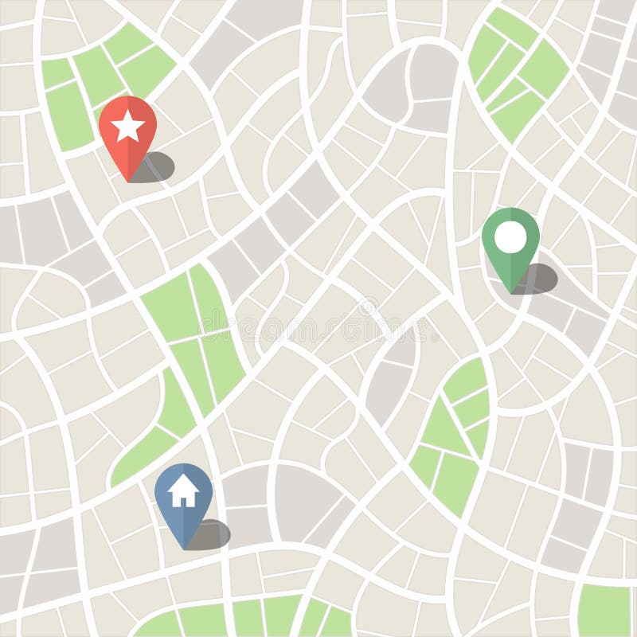
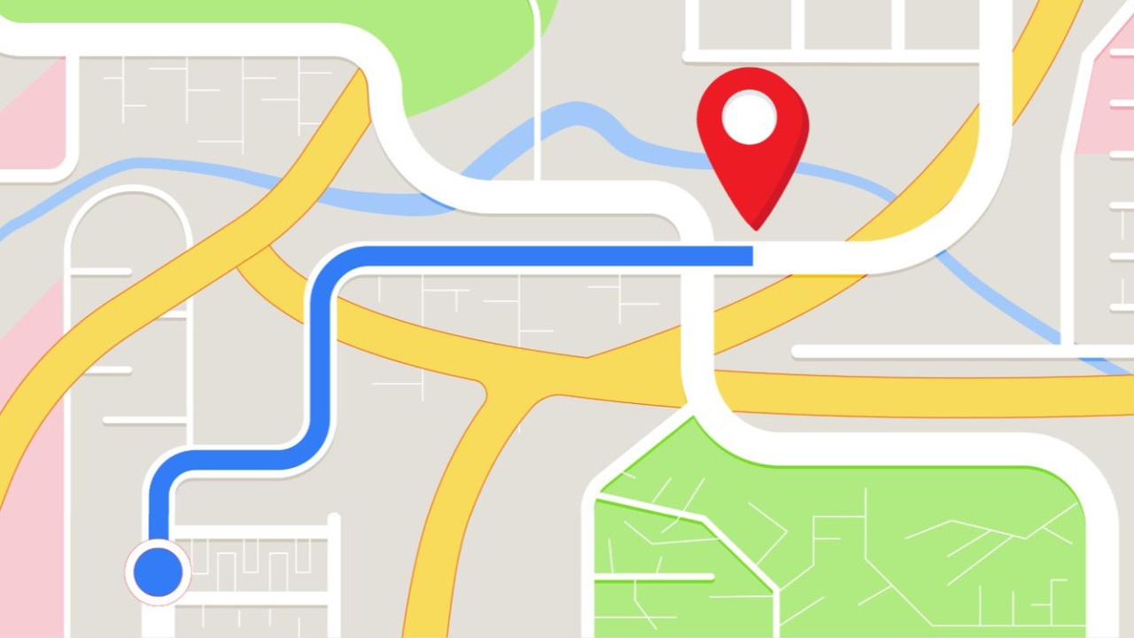
DATABASE STRUCTURE AND DATA TYPES
MARKET TABLE
The market name and its location are recorded in this table.
[MUEA, Buea]
Database
[OIC, Buea]
[GREAT SOPPO, Buea]

Slide 11
DATABASE STRUCTURE AND DATA TYPES
SHOP TABLE
The shop name, vendor name, and market name are stored in this table. The vendor name and market name are referenced from the VENDORS table and MARKET TABLE.
Database
For a particular vendor in a particular market

Slide 12
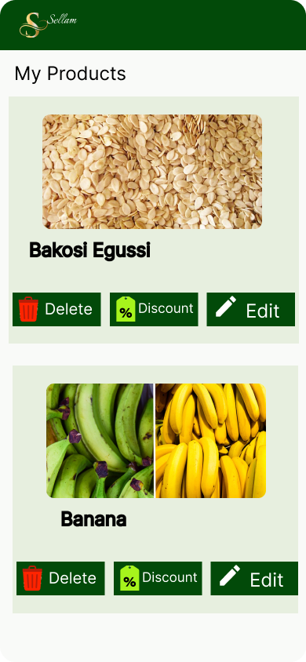
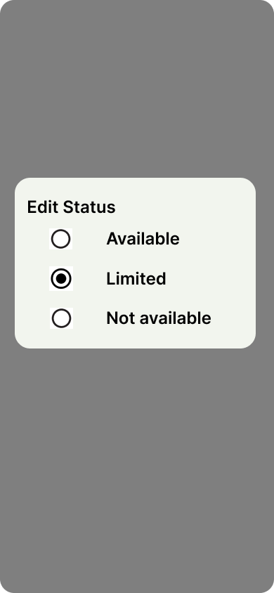
DATABASE STRUCTURE AND DATA TYPES
SHOP PRODUCTS TABLE
The data stored here include the shop name, product name, status of the product (available, limited or not available). The shop name is referenced from the shop table, and the product name is referenced from the product table.
Database
For a particular product of a particular shop

Slide 13

DATABASE STRUCTURE AND DATA TYPES
MARKET PRODUCTS TABLE
It stores the market name, and the product name. They are referenced from the market and product tables respectively.
Database
[SMALL SOPPO, Beans]

Slide 14


